Slide 1
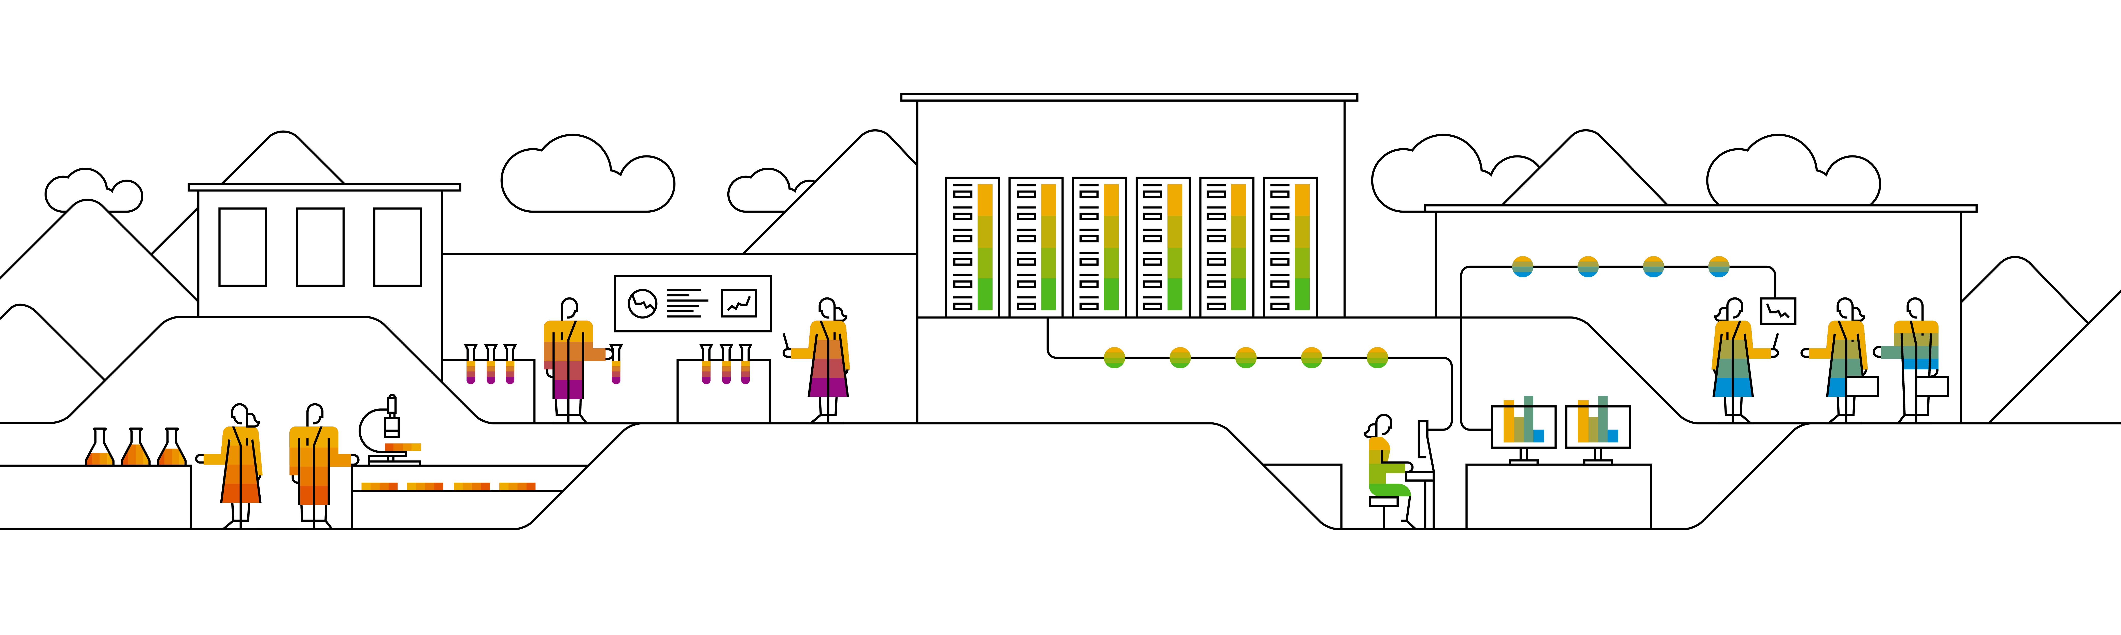
Sentiment Analysis Components
Speaker’s Name, SAP
August 11, 2020
Partner logo

Slide 2
Agenda
Agenda item/divider headline
Details
Agenda item/divider headline
Details
Agenda item/divider headline
Details
Agenda item/divider headline
Details

Slide 3
Divider page

Slide 4
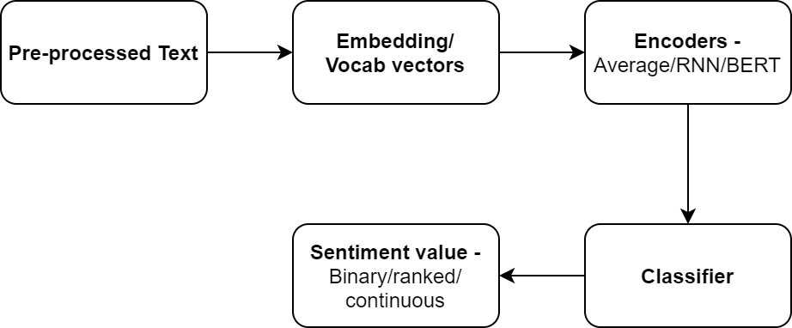
Flow Diagram
Data cleansing
Remove unnecessary text
Text Analysis
Run Sentiment Analysis on HANA to extract among various sentiments the prevailing one.
Expose results
Develop and deploy in HANA an API that will expose the extracted results to a dashboard
Display results
Display results in SAC page
Data extraction
Retrieve and insert data to HANA from 3rd Party APIs
Create connectors with Twitter accounts and store tweets in HANA database
Identify key topics and phrases
Add custom metadata to enhance the sentiment analysis step
In case of many, scoring could be applied
Associate sentiments with phrases appearing to articles
Moving data not required as HANA has built-in web server
Articles list, topics identified, sentiments, scoring between sentiments will be displayed
Focus on G10 currency news.

Slide 5
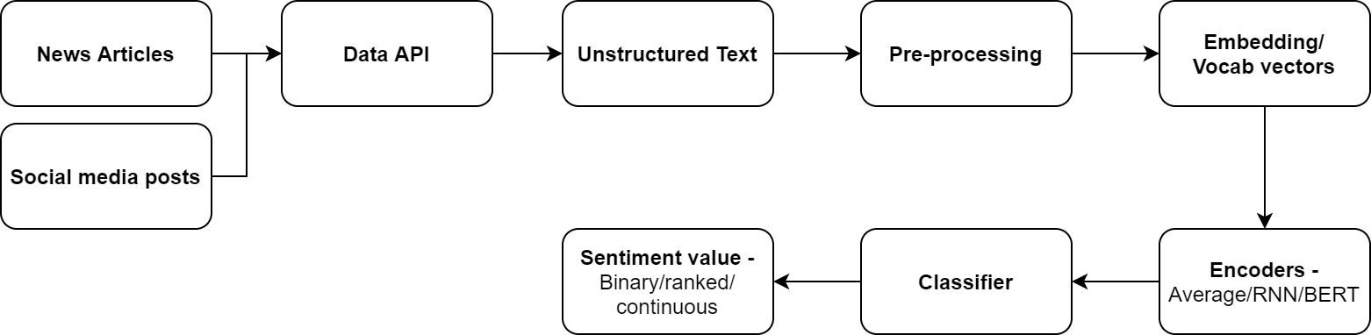
Flow Diagram

Slide 6
Embedding / Vocab vectors
Tokens in the sentence are replaced with vectors that encode the meaning of the word (embeddings).
Embeddings may be trained with data from a particular domain or using universal corpus.

Slide 7
Encoders
This component takes the embeddings of words in a sequence and tries to derive meaning from the sequence of embeddings in terms of a sentence/document encoding.
Example encoder functions
Averaging of word embeddings
RNN – LSTM/GRU
BERT
Tensorflow universal sentence encoder
The final vector represents some meaning of the input sentence in a form that can be used by a classifier.

Slide 8
Classifier
Can be any of the machine learning techniques.
Examples include
SVM
Conditional Random Fields
Neural Networks

Slide 9
Links
Twitter API - http://docs.tweepy.org/en/v3.5.0/api.html
Code for downloading realtime posts - https://github.com/feconroses/gather-tweets-from-stream/blob/master/stream.py
Example project using nltk - https://github.com/saodem74/Sentiment-Analysis-facebook-comments
Example project using Textblob - https://github.com/mehdiassefi/Sentiment-Analysis-on-Social-Media
Example using fuzzy rules - https://github.com/SrishtiVashishtha/Fuzzy-Rule-based-Unsupervised-Sentiment-Analysis-from-Social-Media-Posts
Datasets for topic detection - https://www.cs.umb.edu/~smimarog/textmining/datasets/
Refinitiv Data API –
https://developers.refinitiv.com/eikon-apis/eikon-data-api/quick-start
https://developers.refinitiv.com/all/api-overviews
https://developers.refinitiv.com/open-permid/intelligent-tagging-restful-api

Slide 10
Twitter API
Libraries in python
Tweepy - http://docs.tweepy.org/en/latest/
Twitter API - https://github.com/geduldig/TwitterAPI
searchtweets - https://github.com/twitterdev/search-tweets-python
Search time limit
Standard search API – 7 days
Premium and Enterprise search API – Two options
30 day window
Full archive since March 21, 2006
Rate limit
Limits at minute and second granularity depending on the purchased API.

Slide 11
Tweepy python API
Function Name | Description | Parameters
API.statuses_lookup | Returns full Tweet objects for up to 100 tweets per request, specified by the id_ parameter. | id_ – list of tweet IDs to return
API.get_status | Returns a single status specified by the ID parameter. | id – The numerical ID of the status.
API.search_users | Run a search for users. It is only possible to retrieve the first 1000 matches from this API. | q – The query to run against people search.
API.search | Returns a collection of relevant Tweets matching a specified query. | q – the search query string of 500 characters maximum, including operators result_type – mixed, recent, popular geocode – Returns tweets by users located within a given radius of the given latitude/longitude eg. (18.72363,72.823748,200km)
API.user_timeline | Returns most recent statuses posted from the user specified | [id/user_id/screen_name] – any one user detail count – The number of results to try and retrieve per page. page – Specifies the page of results to retrieve.
API.rate_limit_status | Returns the current rate limits for methods belonging to the specified resource families. | resources – A comma-separated list of resource families you want to know the current rate limit disposition for.

Slide 12
Operators for Twitter Search API
Operator | Finds Tweets...
watching now | containing both “watching” and “now”. This is the default operator.
“happy hour” | containing the exact phrase “happy hour”.
love OR hate | containing either “love” or “hate” (or both).
beer -root | containing “beer” but not “root”.
#haiku | containing the hashtag “haiku”.
from:interior | sent from Twitter account “interior”.
list:NASA/astronauts-in-space-now | sent from a Twitter account in the NASA list astronauts-in-space-now
to:NASA | a Tweet authored in reply to Twitter account “NASA”.
@NASA | mentioning Twitter account “NASA”.
Link to complete list: https://developer.twitter.com/en/docs/twitter-api/v1/tweets/search/guides/standard-operators

Slide 13

Library output formats

Slide 14
Libraries for Sentiment Analysis
Spacy
Has tools for preprocessing text.
Makes use of external models for sentiment analysis.
The external model can be imported into spacy pipeline for classification.
The output of the pipeline depends on the external model.
Classifier Examples
Recurrent Neural Network models (keras, pytorch)
Example: https://github.com/explosion/spaCy/blob/master/examples/deep_learning_keras.py
Classical Algorithms (sklearn)
Example: https://www.dataquest.io/blog/tutorial-text-classification-in-python-using-spacy/

Slide 15
Deeppavlov Sentiment Analysis
Pre-trained Models available
Multi-language BERT (Ru)
5-classes SST on conversational BERT (En)
5-classes SST on multilingual BERT (En)
5-classes Yelp on conversational BERT (En)
Training pipeline
Deeppavlov provides api functions for training model on new data.
Configuration files of a model contain settings for training of the model.

Slide 16
Deeppavlov Examples (5-classes SST on conversational BERT)
You can do this by watching what customers say about you after you launch a new product or even a certain marketing campaign
Neutral
Not for everyone , but for those with whom it will connect , it 's a nice departure from standard moviegoing fare .
Very positive
Though it is by no means his best work , Laissez-Passer is a distinguished and distinctive effort by a bona-fide master , a fascinating film replete with rewards to be had by all willing to make the effort to reap them .
Very positive
Though everything might be literate and smart , it never took off and always seemed static .
Negative
Pricing for this, while relatively inexpensive for a Las Vegas attraction, is completely over the top.
Negative
At such a fine institution, I find the lack of knowledge and respect for the art appalling.
Very Negative

Slide 17
Deeppavlov Examples (5-classes SST on conversational BERT)
You can do this by watching what customers say about you after you launch a new product or even a certain marketing campaign
Deeppavlov: Neutral NLTK: {'neg': 0.0, 'neu': 0.905, 'pos': 0.095, 'compound': 0.2732}
Not for everyone , but for those with whom it will connect , it 's a nice departure from standard moviegoing fare .
Deeppavlov: Very positive NLTK: {'neg': 0.0, 'neu': 0.829, 'pos': 0.171, 'compound': 0.5719}
Though it is by no means his best work , Laissez-Passer is a distinguished and distinctive effort by a bona-fide master , a fascinating film replete with rewards to be had by all willing to make the effort to reap them .
Deeppavlov: Very positive NLTK: {'neg': 0.049, 'neu': 0.711, 'pos': 0.24, 'compound': 0.8625}
Though everything might be literate and smart , it never took off and always seemed static .
Deeppavlov: Negative NLTK: {'neg': 0.0, 'neu': 0.838, 'pos': 0.162, 'compound': 0.4019}
Pricing for this, while relatively inexpensive for a Las Vegas attraction, is completely over the top.
Deeppavlov: Negative NLTK: {'neg': 0.0, 'neu': 0.777, 'pos': 0.223, 'compound': 0.7759}
At such a fine institution, I find the lack of knowledge and respect for the art appalling.
Deeppavlov: Very Negative NLTK: {'neg': 0.232, 'neu': 0.531, 'pos': 0.237, 'compound': 0.0258}

Slide 18
News APIs
NewsAPI - https://newsapi.org/docs
Newscatcher - https://rapidapi.com/newscatcher-api-newscatcher-api-default/api/newscatcher/endpoints
ContextualWeb - https://rapidapi.com/contextualwebsearch/api/web-search/endpoints
AYLIEN - https://docs.aylien.com/newsapi/endpoints/

Slide 19
Relevance Calculation
Highest relevance if the term is present in title
For those not containing the search term in the title, we create categories and assign a relevance based on which category it falls in:
Less than or equal to 2 mentions
More than 2 but less than 4
More than 5

Slide 20
Unaccounted Influencers
THE MARKET PLACE - The marketplace determines share prices. While seller supply and buyer demand meet in the market, there is no perfect equation that lets investors know exactly how share prices will behave.
DEMAND AND SUPPLY - Demand and supply in the market affect the prices of shares. When demand for shares exceeds supply, which means the buyers are more than sellers, the prices increase. When demand is less than supply, meaning that buyers are less than sellers, the prices decrease.
INTEREST RATES - In case of lower interest rates, demand for funds is higher and the subsequent demand for shares rises. On the other hand, high interest lowers the demand for funds and the demand for shares is lower.
INVESTORS - Market players have an impact on share prices. With more bulls than bears, the prices increase. With more bears than bulls, share prices decline.
DIVIDENDS - Dividends indicate the movement of share prices. When companies make dividend announcements, the share prices of such companies are likely to increase. It is important to note that if the dividend rate announced is lower than the investors’ expectations, share prices decline while if they are up to more than expected, share prices increase.
MANAGEMENT - Management profile has a significant effect on company success and stock prices. If management consists of experienced professionals with a proven track record, share prices are likely to be higher. If the management that takes over a company lacks integrity, share prices tend to fall.
ECONOMY - Fluctuations in the economy feature what are commonly referred to as booms and depressions. Under favorable conditions share prices are at their peak and their lowest point is experienced during depressions. Share prices gradually rise during recovery and fall during recessions.
POLITICAL CLIMATE - Political factors that range from relations with other nations to government policies can affect share prices.
SHORT-TERM AND LONG-TERM INVESTORS

Slide 21
Reasons for using time series stock price data
Trying to account for external factors that are not reflected in news data.
Reusing already available data models

Slide 22
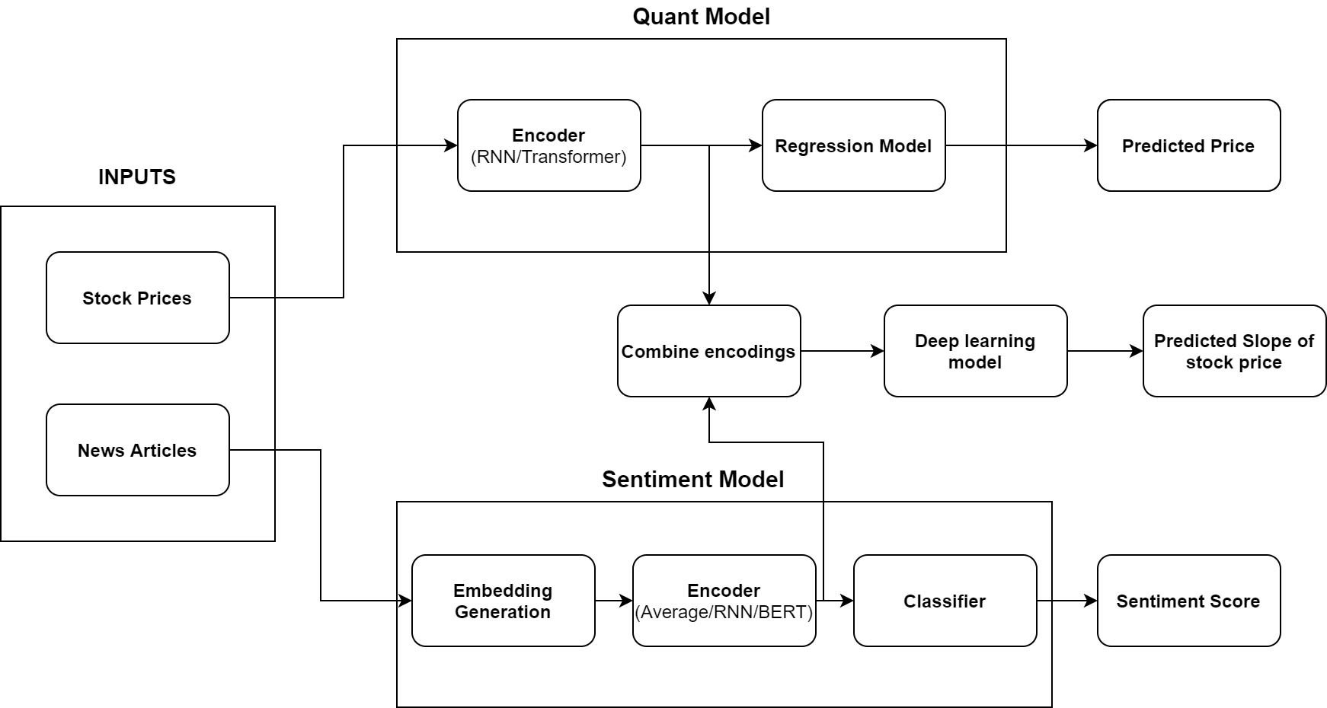
Using stock trends in predicting slope

Slide 23
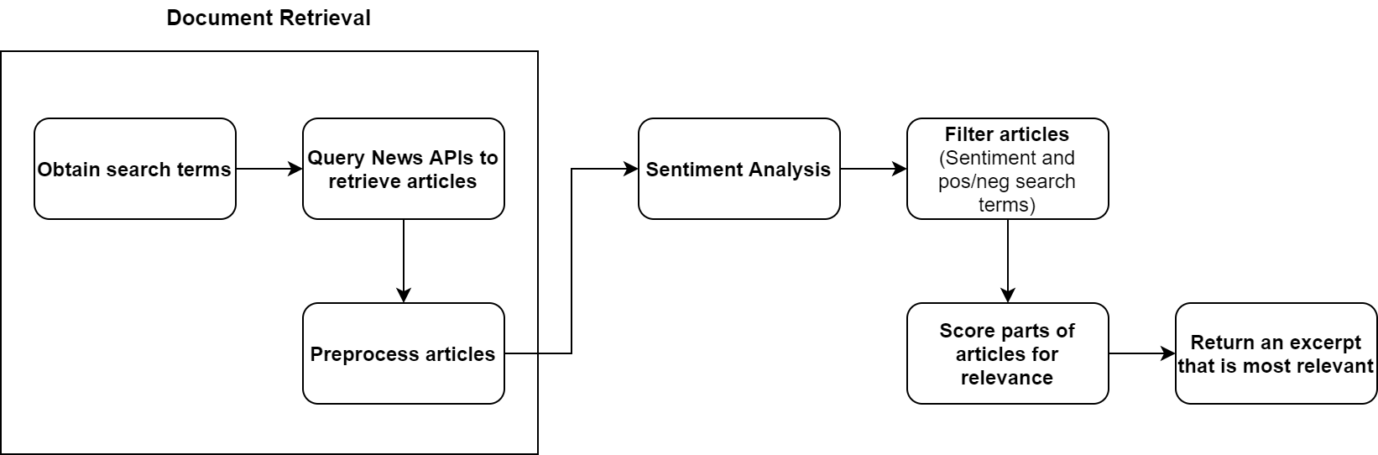

Slide 24
Process Components
Database Preparation
Articles Retrieval
Article Filtering
Relevance Scoring

Slide 25
Database Preparation
News corpora collection
Create lexicons from all historical articles
Word Lexicons
Value Lexicon
Value co-occurrence lexicon
Run data processing techniques to assign feature scores to words and phrases (lexicon).
idf Calculation
Calculate idf for influencing factors in the corpora.

Slide 26
Article Filtering
We assign article fragments into 4 groups for any given currency pair.
Example: We are looking for USD/SGD currency pair. We make 4 groups for the fragments:
Talking about USD
Talking about SGD
Talking about USD/SGD
Talking about SGD/USD
Based on the sentiment of the fragment in these 4 groups we can decide to keep or filter out the article.

Slide 27
Relevance Scoring
We calculate a log tfidf score for each fragment (article) for the influencing factors
log(tf)*idf Calculation -> log(term frequency) * (inverse document frequency)
Inverse document frequency -> log(1/df)
Term frequency normalization - The scoring methods that take into account term frequency (log tfidf) based on the size of the document. The idea of this normalization is to take into account how frequent a term occurs in the document, relative to the other documents in the database.

Slide 28
Improvements to incorporate
Use semantics data to score relevance
Compare terms in the news articles appearing in single day and try to determine what factors are important for that day. Use this importance scores calculated for factors to compute relevance.
Try to identify elements from the constructed lexicon that are directly related to influencing factors and use them for relevance scoring.

Slide 29
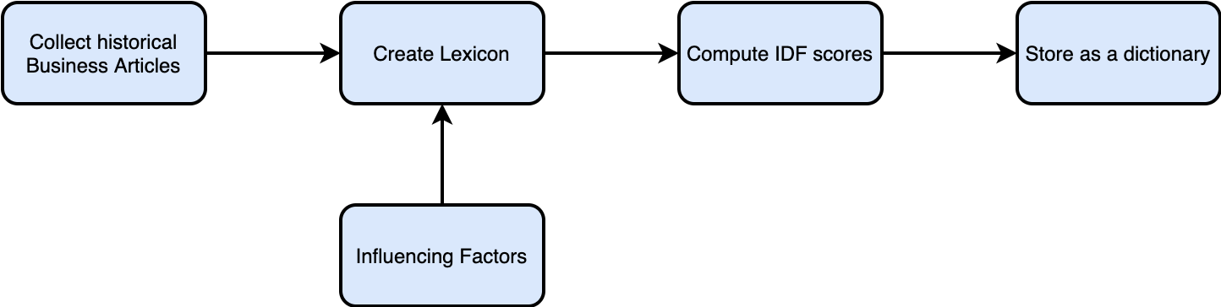
Dataset Preparation

Slide 30
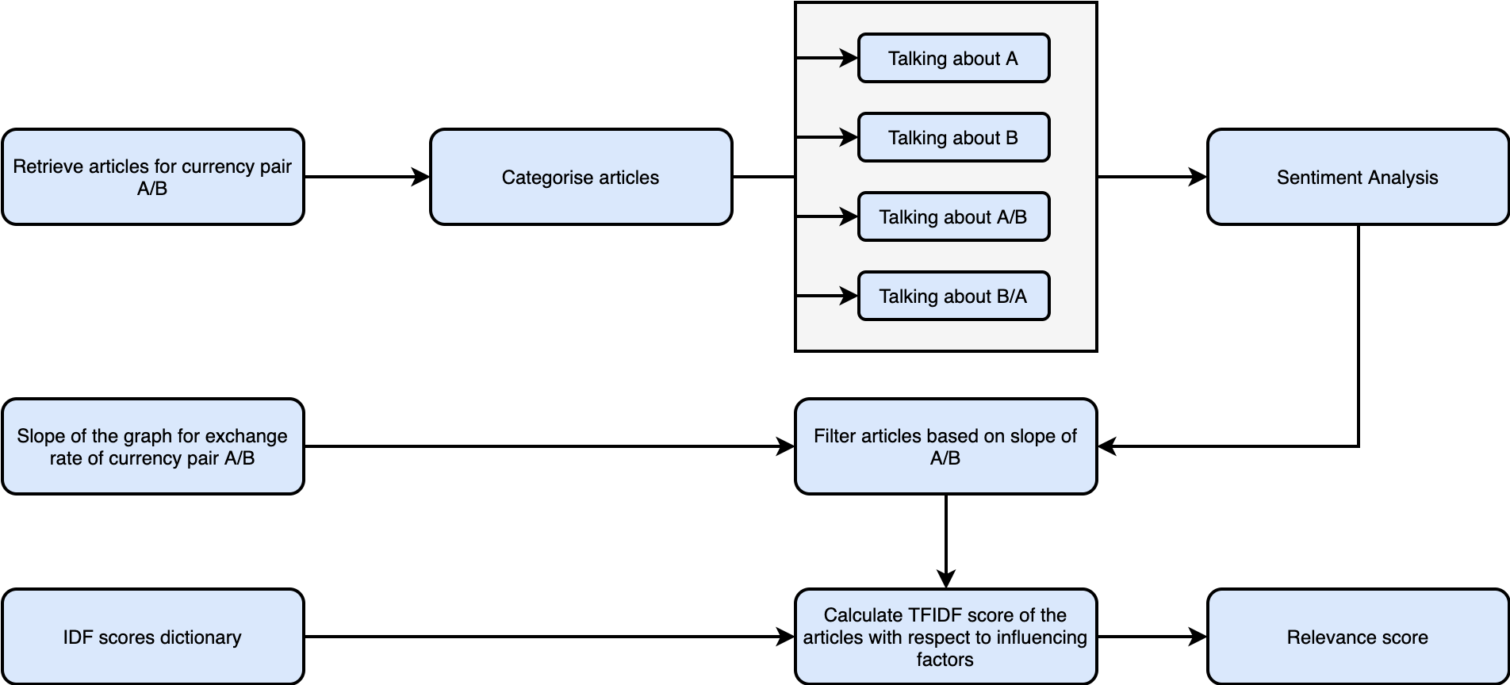
Relevance Scoring

Slide 31
Points to Discuss
Retrieving Articles
Combining scores calculated for 2 countries
Finding context country

Slide 32
Articles Retrieval
Challenges:
Searching together for all factors is difficult
If search is performed one factor at a time many irrelevant articles are returned.
Currently we are trying to manually build a dataset that is suitable for analysis of process flow.
The approach can be later improved as and when we get access to news APIs.

Slide 33
Combining scores computed for two countries in the transaction
Combine sentiment and tfidf score
Methods that can be used:
Arithmetic difference: numerator country score – denominator country score
Difference of logs: log(numerator_score) – log(denominator_score)
Ratio: numerator_score / denominator_score
We need to run experiments to check which method gives acceptable results.

Slide 34
Finding Context Country
In this step we determine the country that relates to an influencing factor mentioned in the article.
There are mainly 3 types of articles:
Articles talking about one single country
Articles comparing two countries
Articles talking majorly about one country with brief mention of some other country
Example article links: https://www.nationalheraldindia.com/opinion/indo-us-ties-contingent-on-indian-economy-reforms-and-openness https://www.pinsentmasons.com/out-law/guides/employment-regulations-in-the-abu-dhabi-global-market
Methods to find context country:
Geographical location (country/state/city) mention frequency
Dependency parse
Coreference resolution

Slide 35
Articles Retrieval
Articles are retrieved using Google News API to get the information with the headers shown below.
Countries and the corresponding influencing factors are identified for a particular transaction.
Various combinations of these countries and influencing factors are used to generate search terms for that transaction.
These generated search terms are then used with the API to retrieve articles.
Examples of search terms: usa india petroleum, usa india gdp, china trade import export.
Date | Source | Author | Title | Article | Summary | Link

Slide 36

Insert page title (sentence case)
First level
Second level
Third level
NOTE: Delete the yellow stickers when finished.
The text placeholders have different, preformatted text levels. Each level has different formatting (font size, indent, bullet).
To jump between the preformatted text levels, use the Increase List Level and Decrease List Level buttons in the Paragraph toolbar.
Type your text in the placeholder.
Click the Increase List Level button in the Paragraph toolbar to go to the next level.
If you need a bullet list, choose level 2.
Avoid working with spaces, other bullets, or bullets in the wrong level. Only when you use the right levels it is possible to reset the slide layout.

Slide 37
Insert page title (sentence case) Subheadline
First level
Second level
Third level

Slide 38
“Quote goes here and here and here.”
Source

Slide 39
“Quote goes here and here and here.”
Source

Slide 40
Insert page title (sentence case)
First level
Second level
Third level

Slide 41
Insert page title (sentence case)
First level
Second level
Third level

Slide 43
Insert page title (sentence case)
First level
Second level
Third level
First level
Second level
Third level

Slide 44
Insert page title (sentence case)
First level
Second level
Third level
First level
Second level
Third level
First level
Second level
Third level

Slide 45
Insert page title (sentence case)
First level
Second level
First level
Second level

Slide 46
Insert page title (sentence case)
First level
Second level
First level
Second level
First level
Second level

Slide 47
Thank you.
Contact information:
F name L name
Title
Address
Phone number
Partner logo

